Slide 1


Developing Great Web APIs Architectures with ASP.NET Core 2.2
Chris Woodruff

Slide 2

Chris Woodruff
chris.woodruff@jetbrains.com
Twitter – @cwoodruff

Slide 3
What do you and I do wrong?
ASP.NET Core 2.2 Web API Architecture

Slide 4
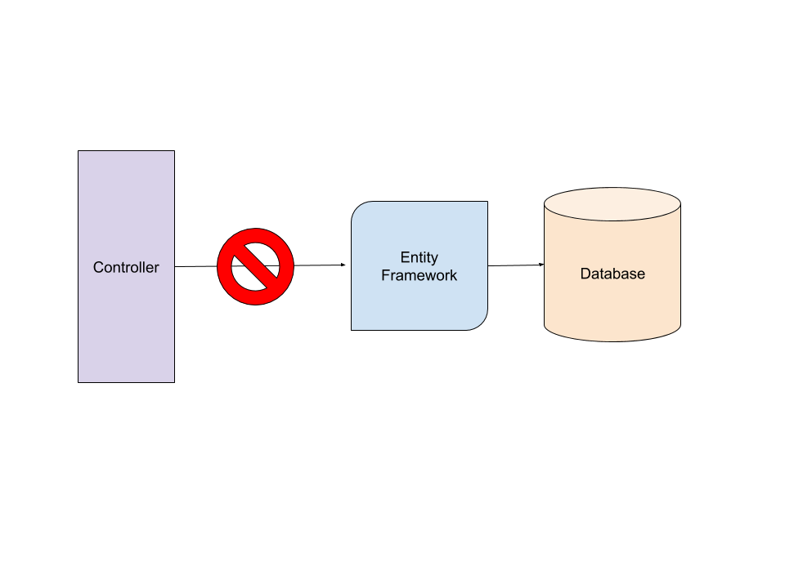
Bad Habits
Calling Data Access functionality (EF Core) from Controllers

Slide 5
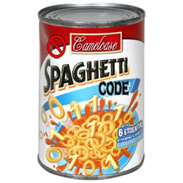
Bad Habits
Having all code in a single project. Hard to test!

Slide 6

Bad Habits
Coupling your Data Access (EF Core) to your project Domain

Slide 7

Bad Habits
Not thinking about Unit or Integration testing

Slide 8
What does ASP.NET Core help us with?
ASP.NET Core 2.2 Web API and the Hexagonal Architecture

Slide 9

Understand the HTTP Protocol

Slide 10
How I build my API’s
API
Domain
Data
Tests

Slide 11
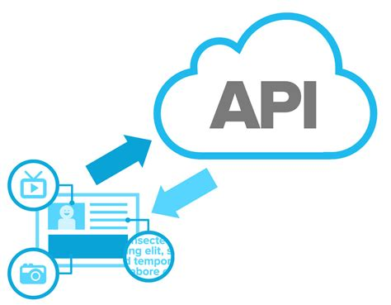
API Layer

Slide 12
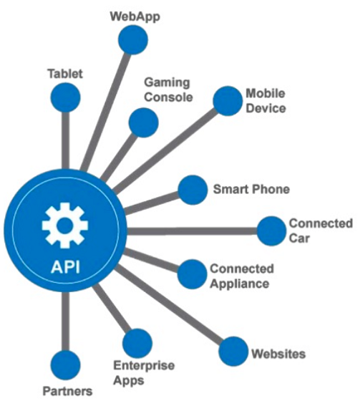
API Layer
Like the UI of an ASP.NET MVC (or any web platform and pattern), the API endpoints should not know about the Domain knowledge or Data Access

Slide 13
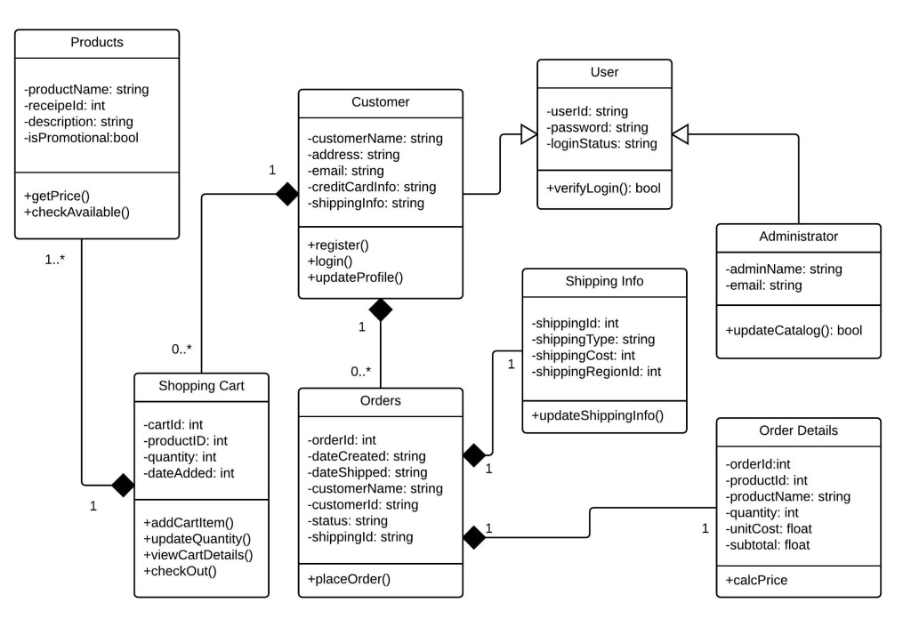
API Layer
Should interact with consumers with ApiModels to ensure the greatest flexibility

Slide 14

Domain Layer

Slide 15
Domain Layer
Contains both my Entity models and my ApiModels for the solution.

Slide 16

Domain Layer
Contains all my interfaces for Data Retrieval so I can keep a well defined standard for my data access.

Slide 17

Domain Layer
Allows me to use Dependency Injection for Repositories

Slide 18
Domain Layer
Think of the Domain Layer as the Supervisor!

Slide 19

Data Layer

Slide 20

Data Layer
Where all the heavy data lifting happens

Slide 21
Data Layer
I have everything defined based on Interfaces from the Domain Layer

Slide 22

Data Layer
I use Entity Framework Core 2.2 but I can use anything that is .NET Standard 2.0

Slide 23

Data Layer
I also Mock up a data layer for testing

Slide 24

Caching

Slide 25
Caching for APIs
Response Caching
In-Memory Caching
Distributed Caching

Slide 26
Response Caching
Directs Caching on the consumer side
HTTP 1.1 Caching specification
Attribute on Controller or Action
[ResponseCache(Duration = 60)]
Response Header:
Cache-Control: public,max-age=60
[ResponseCache(Location = ResponseCacheLocation.None, NoStore = true)]
Response Header:
Cache-Control: no-store,no-cache
Pragma: no-cache

Slide 27

In-Memory Caching
Directs Caching on the consumer side

Slide 28
Distributed Caching
Distributed caches can improve the performance and scalability of ASP.NET Core apps, especially when hosted in the cloud or a server farm.
Cached data is coherent on all web servers. Users don't see different results depending on which web server handles their request
Cached data survives web server restarts and deployments. Individual web servers can be removed or added without impacting the cache
The source data store has fewer requests made to it (than with multiple in-memory caches or no cache at all)

Slide 29
Distributed Caching
Local Redis Cache
SQL Server Cache
Azure Redis Cache
Amazon ElastiCache
Google Cloud Memcache

Slide 30

Testing

Slide 31
Tests
I have 2 types of tests: Integration and Unit
Integration for API endpoint testing and Controllers
Unit Testing to cover the Repositories and Supervisor

Slide 32

https://channel9.msdn.com/Shows/Visual-Studio-Toolbox/Building-Web-APIs-Part-2

Slide 33
Anything to ask?
ASP.NET Core 2.2 Web API and the Hexagonal Architecture

Slide 34
Thanks!
Twitter
@cwoodruff
GitHub
https://github.com/cwoodruff
Email
chris.woodruff@jetbrains.com
Sample project
https://github.com/cwoodruff/ChinookASPNETCoreAPINTier
Articles
https://www.infoq.com/net-core-series

